Slide 1

Dive Into the Pool
PowerShell, Azure SQL, Elastic Database Pools, and Azure Automation

Slide 2


Who am I?
Chris Smith
BIO: 20 year IT Pro. Generalist DevOps Engineer. Types > 80 WPM. Proficient with Google and Stack Overflow. Member of too many Slack channels.
Fusion Alliance (https://fusionalliance.com/)
Twitter: @chlsmith
https://github.com/chlsmith/diveintothepool
csmith@fusionalliance.com

Slide 3
Where Do You Want To Go Today?
Elastic Database Pools
PowerShell
Azure Automation
Azure Metrics
Azure SQL

Slide 4

Who are YOU?

Slide 5


What is PowerShell?
Many things to many people:
Command Line on Steroids
A scripting language
A programming language!
Notes:
How to get into PowerShell
Verb-Noun Syntax and options
Get-Help
Get-Command

Slide 6
How to Get PowerShell
Windows PowerShell
Built on .Net
PowerShell 5.1 is the “finished version”
Included with Windows for several versions as part of the Windows Management Framework
PowerShell Core (PSCore)
Built on dotnetcore
Cross-platform
Open Source and available on Github
Will continue to be developed
Currently v6.2 and v7.0 is in Preview

Slide 7

PowerShell Modules
Like expansion packs for PowerShell
Can come from Microsoft, other companies, or the community
Some you NEED:
Azure PowerShell - https://docs.microsoft.com/en-us/powershell/azure/overview?view=azps-2.6.0
SqlServer - https://docs.microsoft.com/en-us/sql/powershell/sql-server-powershell?view=sql-server-2017
DBA Tools - https://dbatools.io/
Notes:
Mention that you can make your own and contribute OR just save them for yourself for later

Slide 8

Your To-Do List
DOWNLOAD PowerShell Core (PSCore)
https://github.com/PowerShell/PowerShell
DOWNLOAD and INSTALL the modules on the previous slide
READ the “Monad Manifesto”!
https://www.jsnover.com/Docs/MonadManifesto.pdf
WATCH a PowerShell Training with Jeffrey Snover
https://www.youtube.com/watch?v=fyWFIn4lF6c

Slide 9

Azure SQL Database
Fully managed database solution with 99.99% availability
Connect with the tooling you expect (SSMS, Azure Data Studio)
Notes:
Don’t forget that this information gets outdated quickly

Slide 10

Azure SQL Pricing
https://azure.microsoft.com/en-us/pricing/calculator/?service=sql-database
This Photo by Unknown Author is licensed under CC BY-SA

Slide 11

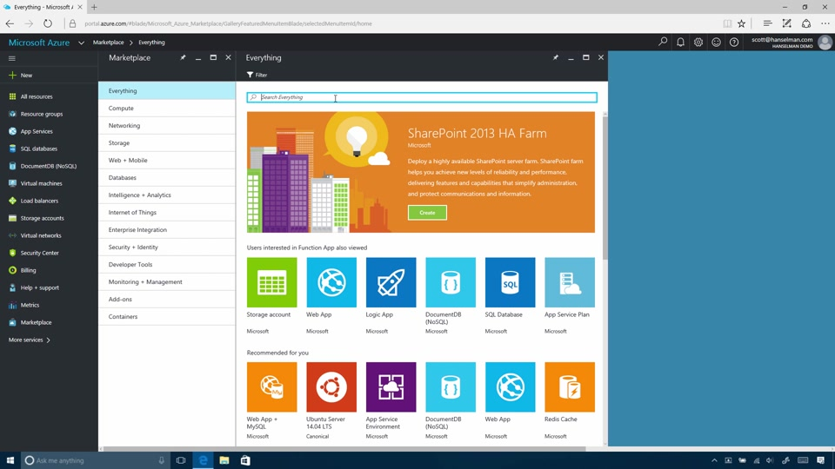
Your To-Do List
SIGN UP for a free Azure account
https://azure.microsoft.com/en-us/free/
STAND UP a “server”
DEPLOY a few tiny databases
SET overall firewall rules
CONFIGURE your backups
PLAY in the portal to see what else you can do!
Notes:
Why the quotation marks around server???
Mention performance recommendations and automatic query tuning
MAKE SURE TO DELETE WHEN YOU’RE FINISHED OR YOU’LL EAT UP YOUR FREE MONEY QUICKLY

Slide 12

Azure SQL Elastic Database Pools
One provisioned chunk of compute and storage for you to throw your databases onto
Can be provisioned upon the DTU (aka “eDTU”) or vCore models
Individual DBs can eat as much of the provisioned power as they require at a time
If a DB takes all the resources, the others in the pool will be degraded

Slide 13

Elastic Pool Use Cases
Many small databases
Member database use occurs at different times of the day
Development or test databases where performance is less important than in production
Notes:
Show how to move a DB into the pool and around
Show configuring individual dbs for specific max usages

Slide 14

My Particular Problem
Multi-tenant retail solution (> 800 DBs)
Tenants on 5 Continents
GDPR rules regarding data in Europe
Require some level of “regionality” between the data and the app servers for performance

Slide 15

Why use Elastic DB Pools?
No database was bigger than 1.5 GB
Retailers mostly open 10am-8pm in their own time zone
800*$144 per month = A HUGE MONTHLY BILL
Split DBs into regional pools (East US 2, West US 2, West EU, Japan East, Australia SE)
Largest pool had about 200 DBs at ~$300 per month
Notes:
Grand total monthly bill was < $1500 per month for the whole solution

Slide 16

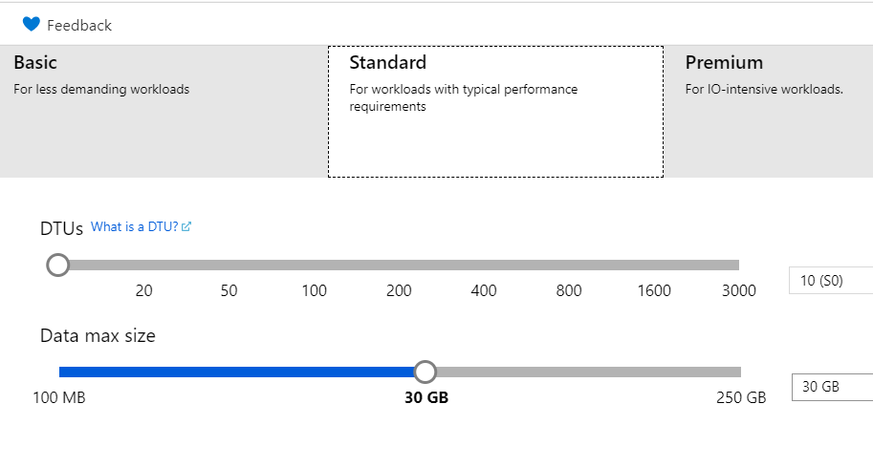

Azure SQL DB Scaling
Scale with a slider in the portal
DTU vs. vCore scaling

Slide 17

Azure Automation

Slide 18
An Extra Set of Hands
YOUR scripts
AZURE hosts
YOUR Triggers
Notes:
You write the scripts either in the portal or can keep in source control
Automation jobs run on hosted systems that you don’t have to touch
You can trigger the jobs on a schedule or via a webhook or VIA A METRICS ALERTING RULE!!!

Slide 19

Azure Automation in Action
Notes:
Show the basic setup
Show the runbook that will scale up or down an elastic db pool

Slide 20

Your To-Do List
READ the Azure Automation Documentation
https://docs.microsoft.com/en-us/azure/automation/automation-intro
READ up on Importing Az Modules to Azure Automation
https://docs.microsoft.com/en-us/azure/automation/az-modules
CREATE your own Automation Account and Play!

Slide 21

What’s Wrong with This?
What if my usage requirements aren’t well understood?
Do I have to go into Azure Automation to run it every time manually?
Isn’t it just as easy to hit the scaling slider?

Slide 22
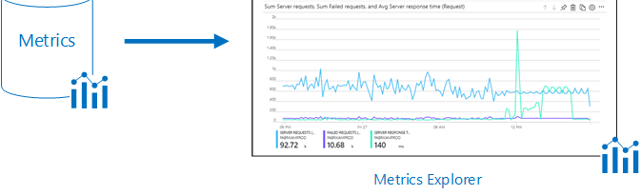
Azure Metrics
Monitor your assets
Alerting
Action Groups
Notes:
Show the basic performance charts
Create an alert
Create an Action Group
Show that you can run an automation runbook with it!

Slide 23

Your To-Do List
CHECK OUT all the sweet Azure Metrics Dashboards
CREATE your own Action Group and Alert
PLAY with all the things you can Dashboard in the Azure Portal

Slide 24

Other Potential Solutions
Elastic Database Jobs
Logic Apps
Azure Functions

Slide 25

THE FUTURE
PowerShell Core continues to grow and thrive
“Serverless” Databases
Azure Metrics continue to improve
We won’t have to do ANYTHING!!!

Slide 26

What We’ve Learned
Basics of PowerShell
Azure SQL Overview
SQL Elastic Database Pools
Azure Automation
Azure Metrics

Slide 27



